Slide 1
Phonepe Pulse Data Visualization and Exploration: A User-Friendly Tool Using Streamlit and Plotly
Presented By
Janani.J

Slide 2
Technologies
Github Cloning
Python
Pandas
MySQL
mysql-connector-python
Streamlit and Plotly.

Slide 3
Problem Definition
The PhonePe Pulse Data Visualization and Exploration project aims to provide an interactive platform for analyzing and visualizing various metrics related to digital payments and user engagement on the PhonePe platform. By leveraging data visualization tools and interactive components, this project enables users to gain valuable insights into transaction patterns, user registration trends, and app usage across different states and districts over various time periods.

Slide 4
Abstract
The goal is to extract this data and process it to obtain
insights and information that can be visualized in a user-friendly manner.
The solution must include the following steps:
1. Extract data from the Phonepe pulse Github repository through scripting and
clone it..
2. Transform the data into a suitable format and perform any necessary cleaning

Slide 5
3. Insert the transformed data into a MySQL database for efficient storage and
retrieval.
4. Create a live geo visualization dashboard using Streamlit and Plotly in Python
to display the data in an interactive and visually appealing manner.
5. Fetch the data from the MySQL database to display in the dashboard.
6. Provide at least 10 different dropdown options for users to select different facts and figures to display on the dashboard.

Slide 6
Approach:
Data extraction
Data transformation
Database insertion
Dashboard creation
Data retrieval
Deployment

Slide 7
WORK FLOW
Github Repository
Data Extraction
Data Transformation
Database Insertion
Data Retrieval
Data
Visualization

Slide 8
Here we are analysing 3 types of data :
Aggregated
Aggregated Transaction
Aggregated User
Map
Map Transaction
Map User
Top
Top Transaction
Top User

Slide 9
Key Objectives
Interactive Data Exploration: Allow users to interactively explore data through various filters such as state, year, and quarter.
Visual Insights: Utilize visualizations to represent complex data in an easy-to-understand manner.
Trend Analysis: Identify trends and patterns in digital payments and user behavior.
User-Friendly Interface: Develop a user-friendly interface that makes data exploration accessible to non-technical users.

Slide 10
Data Visualization Features
Bar Charts: Display transaction counts and amounts by state, district, or year.
Line Charts: Show trends in user registrations and app opens over time.
Scatter Plots: Analyze the relationship between transaction counts and amounts by pincode.
Pie Charts: Visualize the distribution of transactions among different categories.
Heatmaps: Provide a visual representation of transaction density across regions.

Slide 11
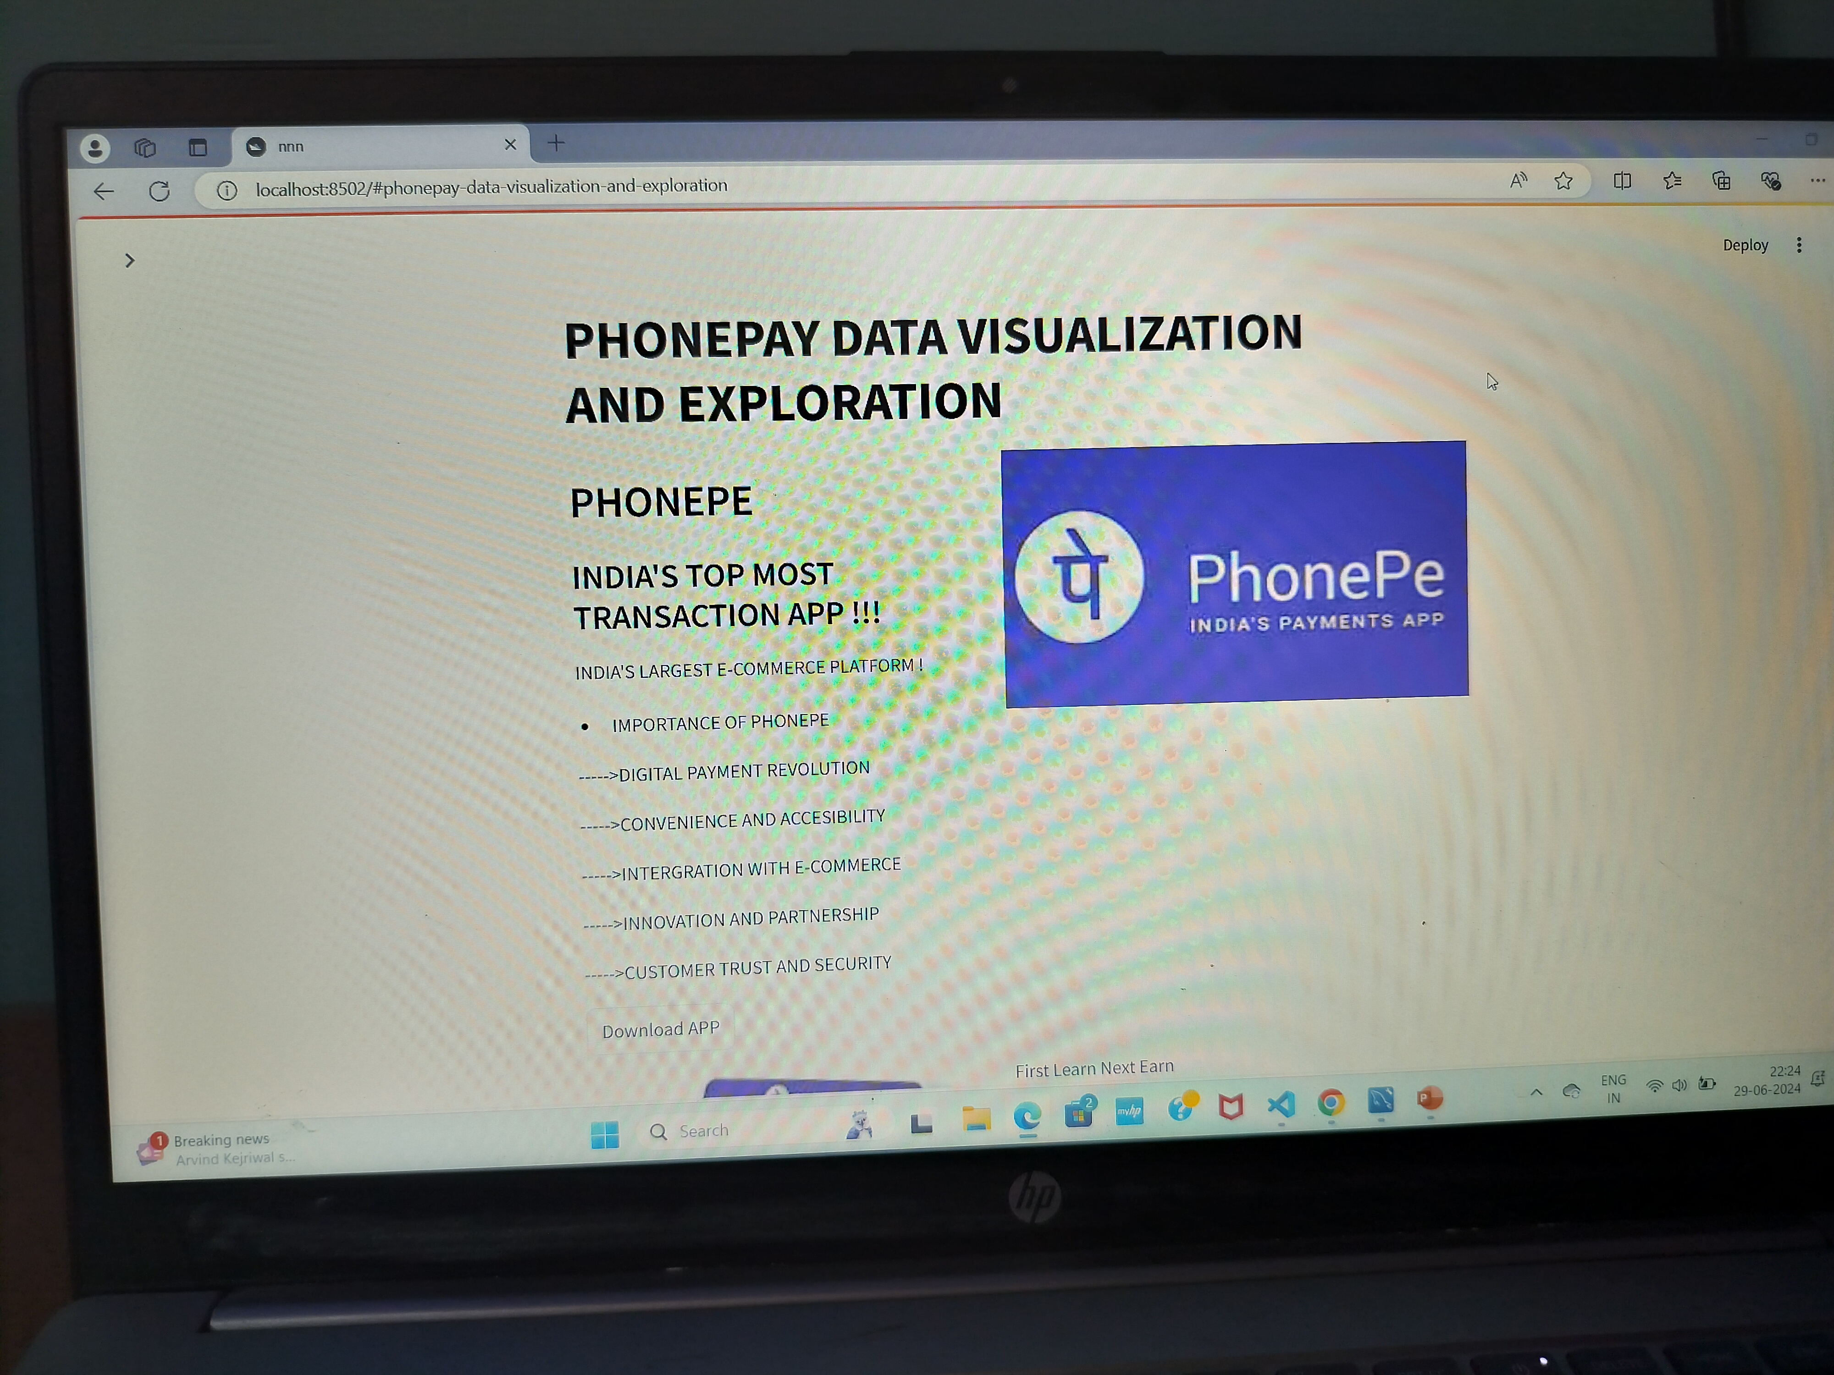

Slide 12
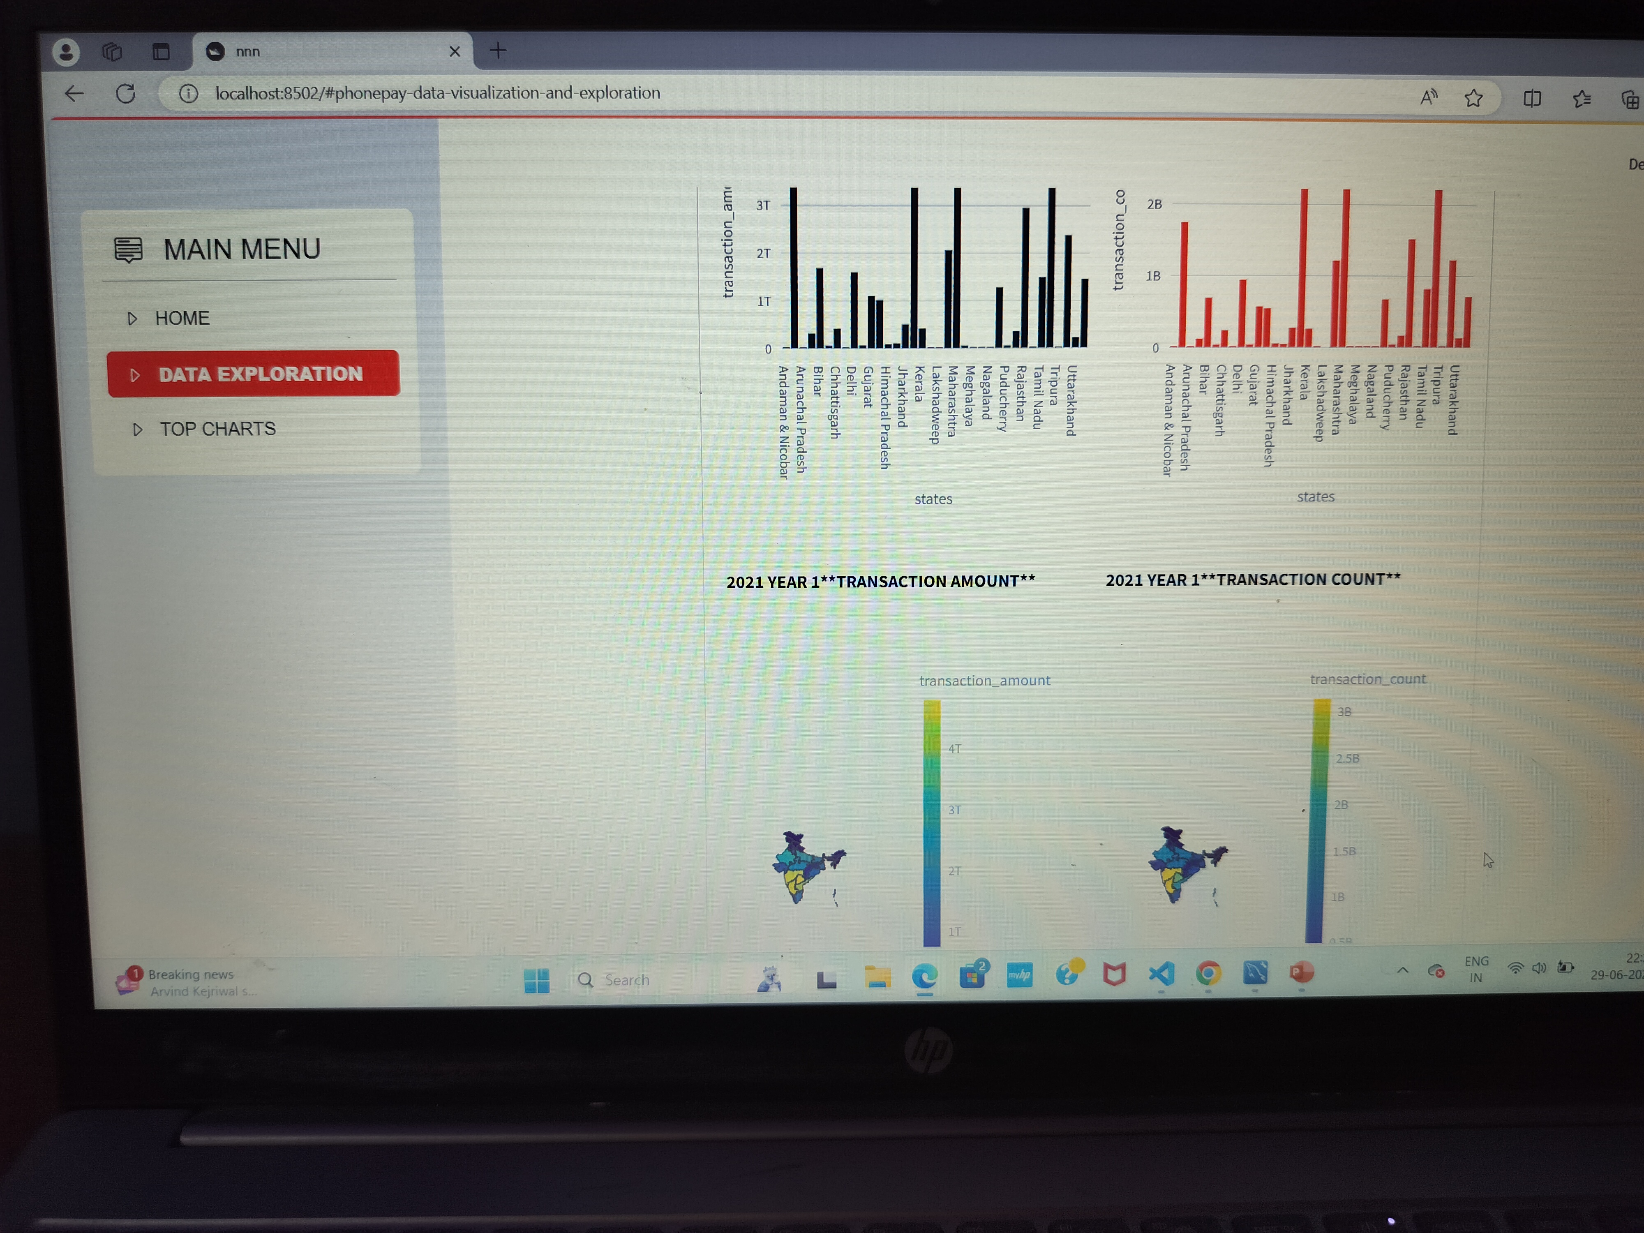
Screen Short

Slide 13
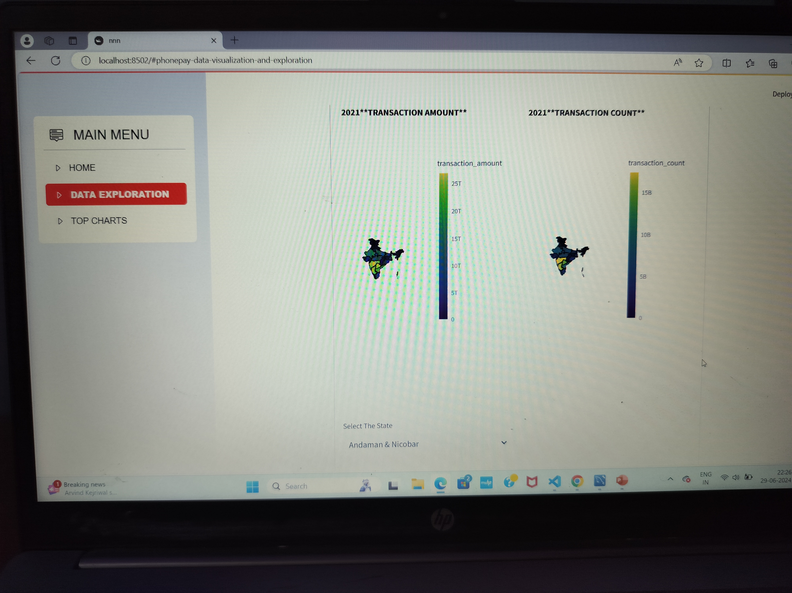

Slide 14
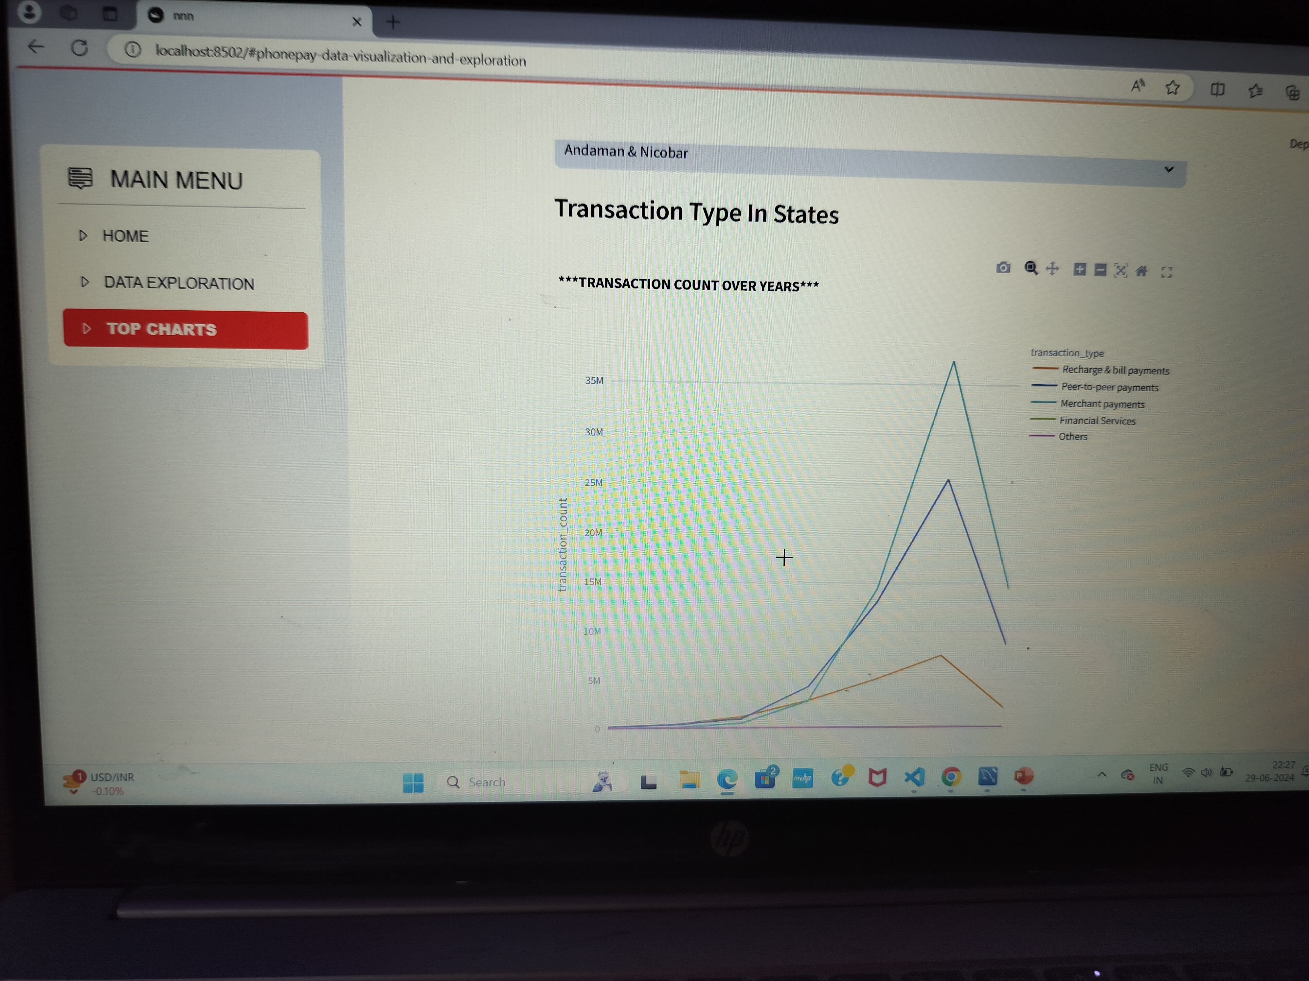

Slide 15
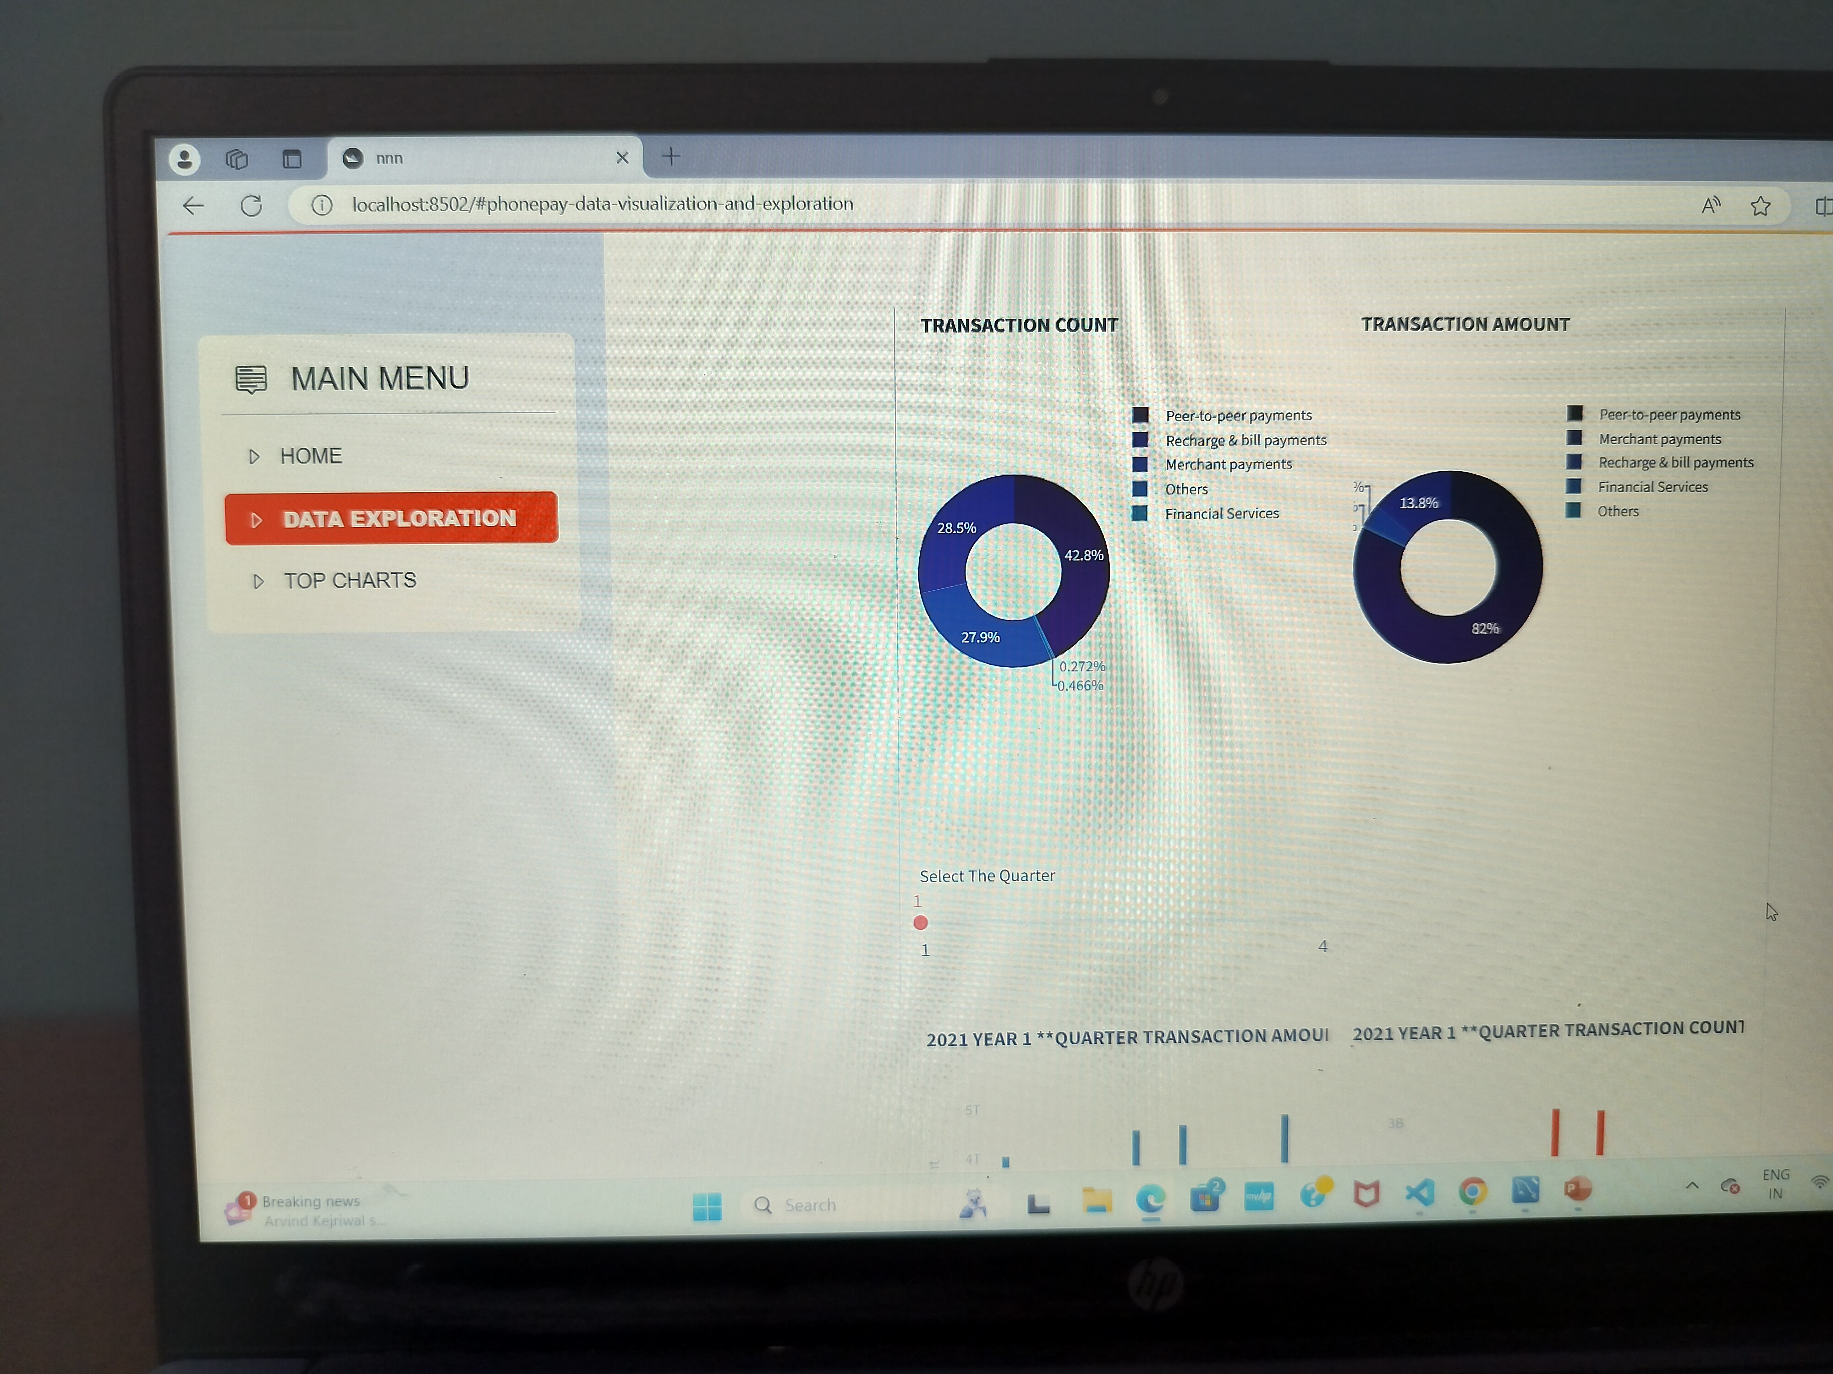

Slide 16
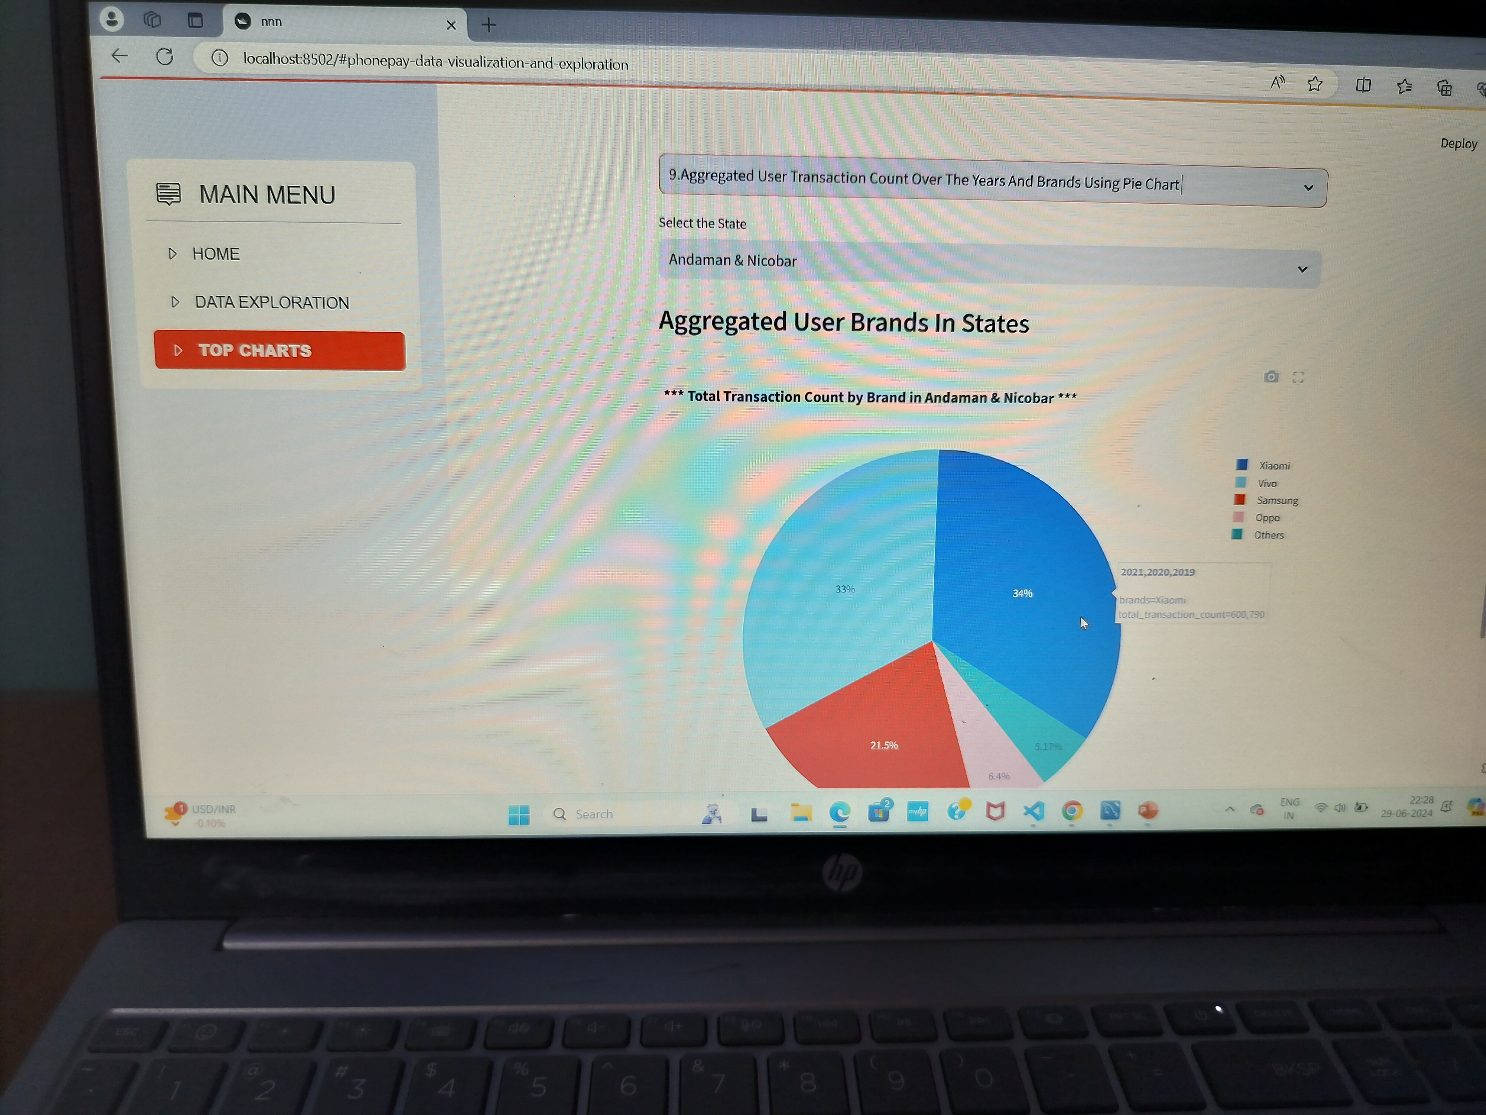

Slide 17
Conclusion
The PhonePe Pulse Data Visualization and Exploration project provides a powerful tool for analyzing digital payment trends and user engagement. By integrating interactive filters and dynamic visualizations, users can gain deep insights into the data, aiding decision-making and strategy development.

